Slide 1
Libraries

Slide 2
Introduction
Many basic tasks are very hard for programming beginners.
The standard C libraries include functions to perform mathematical calculations, character analysis and character manipulation, …etc.
Library header files have the extension .h
Library binary files are implemented in files with specific filenames which are named by designers of tool suppliers (you may not know their names) and they are linked to your programs when they are compiled.
Lib.h
include
File.c
compile
File.obj
link
File.exe
Library binary code
Steps for creating a program

Slide 3
Objectives
After studying this chapter, you should be able to use the following build-in libraries:
Stardard and Math libraries: stdlib.h, math.h → Mathematical Functions
Time library: time.h
The Character library: ctype.h

Slide 4
Contents
The standard C libraries
Standard
Math
Time
Character

Slide 5
1 - Standard Library
The header file <stdlib.h> contains prototypes for the functions that perform the more general mathematical calculations.
Integer absolute value:
Function | Syntax | Description
abs() | int abs(int); | return the absolute value of the argument
labs() | long labs(long);
llabs() | long long llabs(long long);

Slide 6
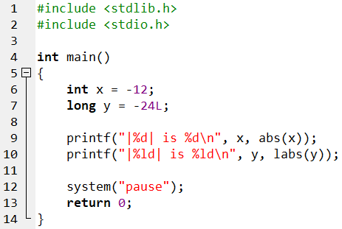
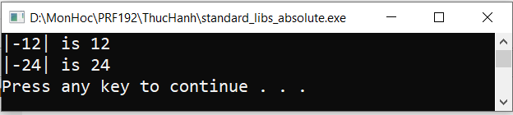
Integer absolute value: Example

Slide 7
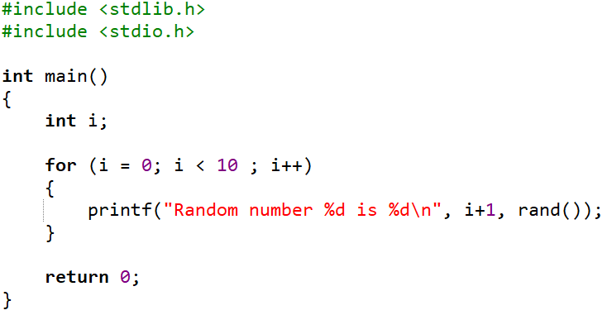
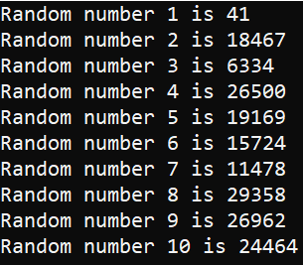
Random Number
rand(): returns a pseudo-random integer in the range 0 to RAND_MAX. RAND_MAX is implementation-dependent but no less than 32767.
Syntax:
Example 1:
int rand(void);

Slide 8
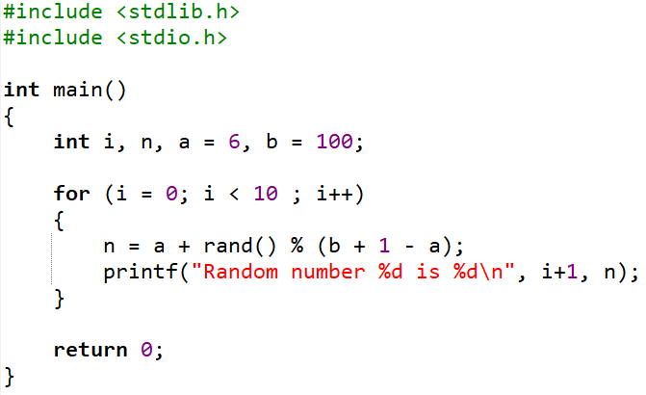
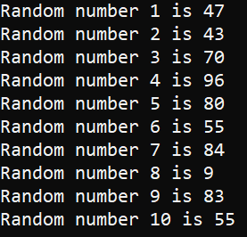
Random Number: Example
Example 2: Random a set of 10 pseudo-random integers between 6 and 100

Slide 9
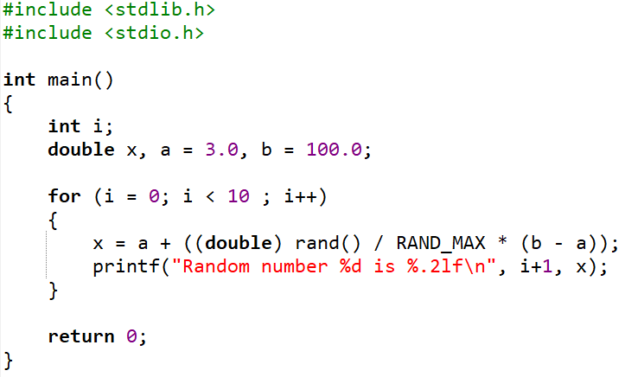
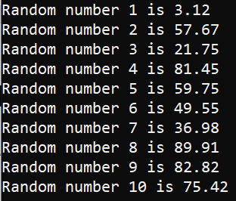
Random Number: Example (cont.)
Example 3: Random a set of 10 pseudo-random floating-point numbers between 3.0 and 100

Slide 10
Random Number (cont.)
To generate a different set of random numbers for every run we add a call to the function srand(). srand() sets the seed for the random number generator.
Syntax:
Note:
unsigned is a type that only holds non-negative integer values.
Call srand() once with time(NULL) as the argument before the first call to rand(), typically at the start of your program.
int srand(unsigned seed);

Slide 11
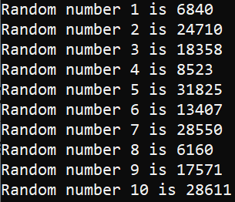
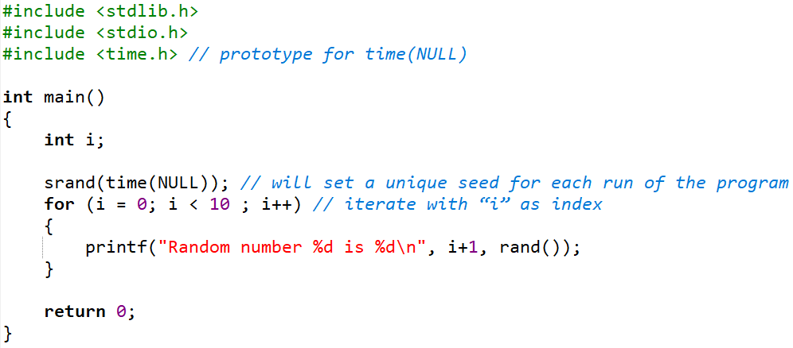
Random Number: Example
Program outputs a different set of 10 pseudo-random numbers with every run:

Slide 12
Math Library
The math library contains many functions that perform mathematical calculations.
Their prototypes are listed in <math.h>
Common Functions | Syntax | Description | Example
fabs() fabsf() | double fabs(double); float fabsf(float); | return the absolute value of the argument | fabs(-12.5) → 12.5 fabsf(-12.5f) → 12.5
… | … | … | …

Slide 13
Math Library- math.h (cont.)
Common Functions | Syntax | Description | Example
floor() floorf() | double floor(double); float floorf(float); | return the largest integer value not greater than the argument | floor(16.3) → 16.0
ceil() ceilf() | double ceil(double); float ceilf(float); | return the smallest integer value not less than the argument | ceil(16.3) → 17.0
round() roundf() | double round(double); float roundf(float); | return the integer value closest to the argument | round(16.3) → 16.0 round(-16.3) → -16.0
trunc() truncf() | double trunc(double); float truncf(float); | return the integer part of the argument | trunc(16.7) → 16.0 trunc(-16.7) → -16.0
sqrt() sqrtf() | double sqrt(double); float sqrtf(float); | return the square root of the argument | sqrt(16.0) → 4.0

Slide 14
Math Library - math.h (cont.)
Common Functions | Syntax | Description | Example
pow() powf() | double pow(double base, double exponent); float powf(float base, float exponent); | return the result of the first argument raised to the power of the second argument | pow(12.5, 3)) → 1953.125
log() logf() | double log(double); float logf(float); | return the natural logarithm of the argument | log(2.718281828459045) → 1.0
exp() expf() | double exp(double); float expf(float); | return the natural anti-logarithm of the argument. | exp(1.0) → 2.718281828459045

Slide 15
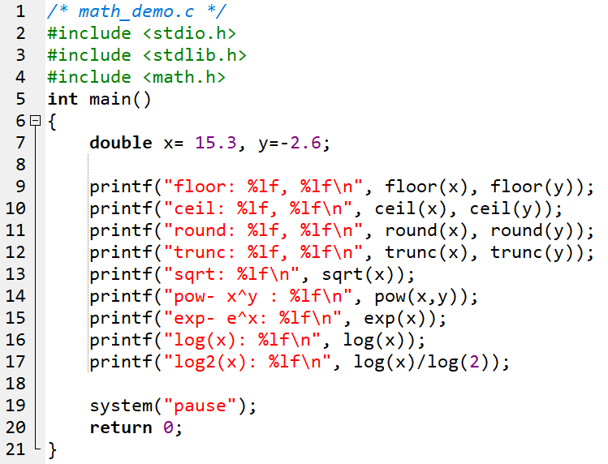
Math Library: Demo
Write, compile and run this program

Slide 16
2 - Time Library: time.h
Date and time information is presented in computer using an integral number. It is usually the data type long.
A clock tick is the unit by which processor time is measured and is returned by 'clock'.
CLOCKS_PER_SEC: Number of clock ticks per second. A constant is defined in time.h (in Dev C++, CLOCKS_PER_SEC =1000 means that 1 clock tick = 1milisecond).
2 data type are defined in the library time.h
time_t : ( in DevC++: typedef long time_t;)
clock_t : ( in DevC++: typedef long clock_t;)

Slide 17
Time Library: time.h (cont.)
Common used functions
time_t time ( time_t *tptr ); returns the current calendar time and this time is stored in it’s parameter.
double difftime ( time_t , time_t ); returns the difference in seconds between two calendar time arguments.
clock_t clock ( void ); returns the current date time information using the unit clock tick
We can use these function to evaluate time cost for an algorithm.

Slide 18
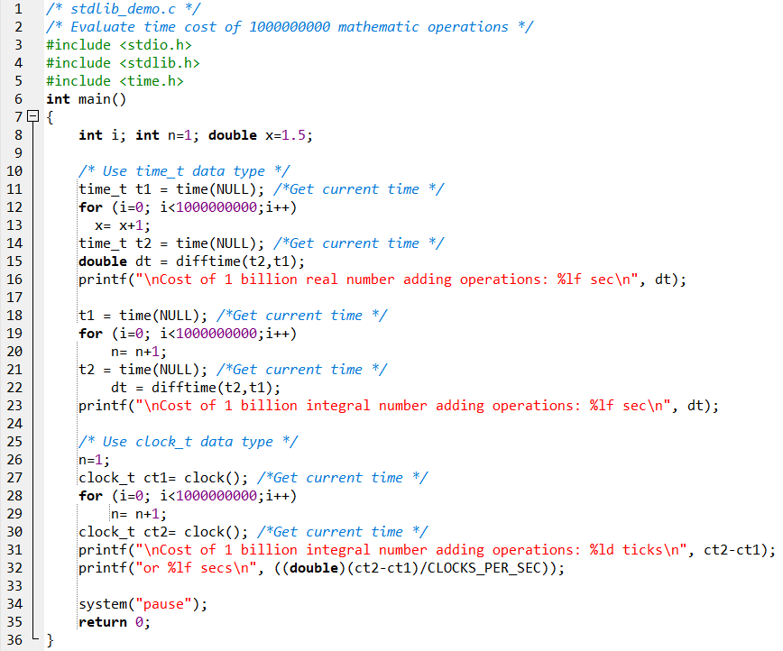
Time Library: Demo
Write, compile and run this program

Slide 19
3 - The Character Library (ctype.h)
The <ctype.h> header provides many functions for classifying and modifying characters.
Common Functions | Description
isalnum() | Checks whether a character is alphanumeric
isalpha() | Checks whether a character is a letter
isblank() | Checks whether a character is a space or tab
isdigit() | Checks whether a character is a decimal digit
islower() | Checks whether a character is a lowercase letter
isupper() | Checks whether a character is an uppercase letter
isspace() | Checks whether a character is a whitespace character
tolower() | Returns a lowercase version of a character
toupper() | Returns an uppercase version of a character

Slide 20
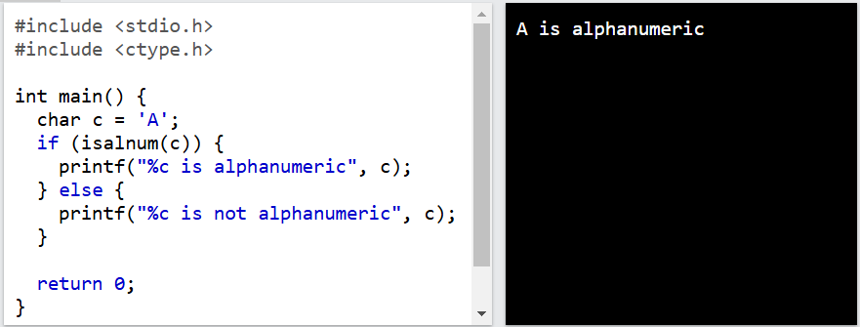
isalnum() Function
The isalnum() function returns a non-zero value (equivalent to boolean true) if a character is alphanumeric, meaning an alphabet letter (a-z) or a number (0-9).
Example of characters that are not alphanumeric: (space)!#%&? ...etc.
Syntax: int isalnum(int c);
Example:

Slide 21
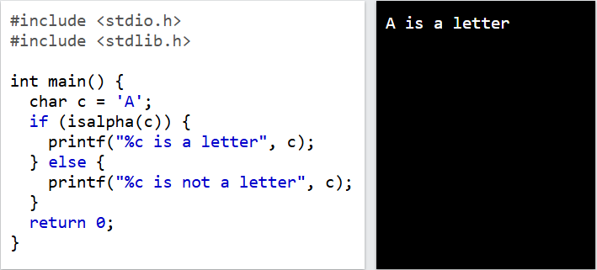
isalpha() Function
The isalpha() function returns a non-zero value (equivalent to boolean true) if a character is an alphabet letter (a-z).
Syntax: int isalpha(int c);
Example:

Slide 22
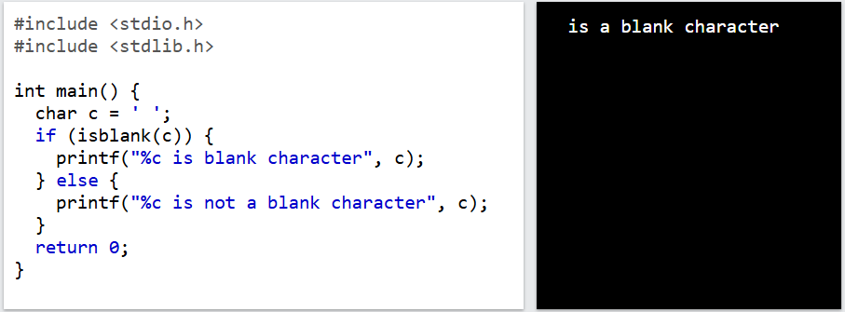
isblank() Function
The isblank() function returns a non-zero value (equivalent to boolean true) if a character is a space (blank) or a tab.
Syntax: int isblank(int c);
Example:

Slide 23
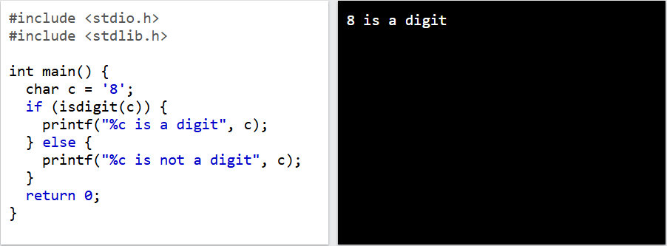
isdigit() Function
The isdigit() function returns a non-zero value (equivalent to boolean true) if the character is a digit.
Syntax: int isdigit(int c);
Example:

Slide 24
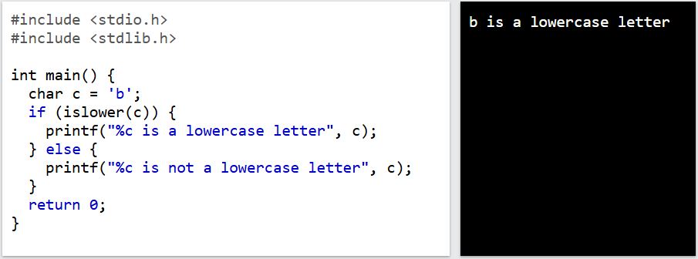
islower() Function
The islower() function returns a non-zero value (equivalent to boolean true) if a character is a lowercase letter.
Syntax: int islower(int c);
Example:

Slide 25
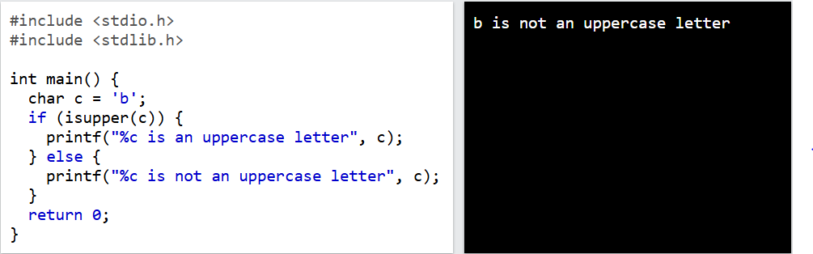
isupper() Function
The isupper() function returns a non-zero value (equivalent to boolean true) if a character is an uppercase letter.
Syntax: int isupper(int c);
Example:

Slide 26
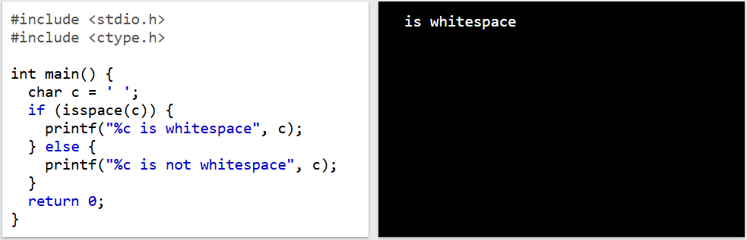
isspace() Function
The isspace() function returns a non-zero value (equivalent to boolean true) if a character is a whitespace character. Whitespace characters are spaces, tabs and newline characters.
Syntax: int isspace(int c);
Example:

Slide 27
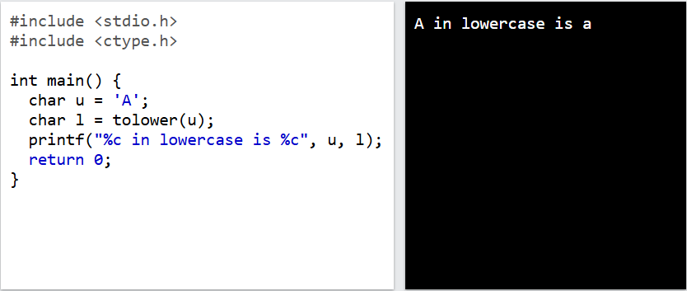
tolower() Function
The tolower() function returns the ASCII value of a lowercase version of the character.
Syntax: int tolower(int c);
Example:

Slide 28
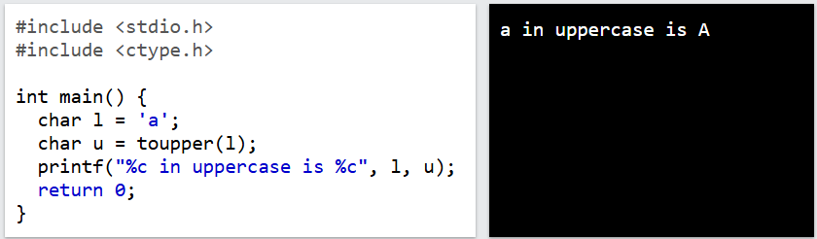
toupper() Function
The toupper() function returns the ASCII value of an uppercase version of the character.
Syntax: int toupper(int c);
Example:

Slide 29
Exercise 1: Character Classification
Write a program that takes a character as input and determines:
Whether it is a digit, uppercase letter, lowercase letter, or none of these.
If it is a letter, convert it to the opposite case (uppercase to lowercase and vice versa).

Slide 30
Summary
The standard C libraries
Standard: stdlib.h
Time: time.h
Math: math.h
Character: ctype.h
Q&A

Slide 31
Input and Validation

Slide 32
Contents
Types of Input
Input a character: getchar()
Input data: scanf(…)
Input Validation

Slide 33
1 - Types of Input
Unbuffered Input
User
Device
Program
var
Buffered Input
User
Device
Device buffer
Program
var
Interactive program (event-based program) uses unbuffered input. The program can respond to each and every keystroke directly.
Buffer: A memory region is associated with a hardware such as keyboard, monitor, hard disk, … It holds data temporarily.
Buffered input enables data editing before submission to a program. That means that input data can be treated as units and they can be pre-processed before they are passed to the program.
Input functions will access device buffer to get data.

Slide 34
Buffered Input
To transfer the contents of a buffer to a program the user must press the '\n' character.
Stream: A concept allows generalizing access data in a buffer as a chain of characters.
Two C functions provide buffered input, using standard library <stdio.h>
getchar(): get a character from the keyboard
scanf (…): get data from the keyboard

Slide 35
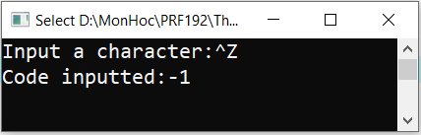
2 - The getchar() function
getchar() retrieves a single character from the standard input stream buffer without translating the input.
Syntax: int getchar(void);
getchar returns either the character code for the retrieved character or EOF.
(EOF=-1, ctrl+z in Windows, ctrl+d in Unix)
Copy. Paste, compile and run the program with input: Ctrl + Z
#include <stdio.h>
int main()
{
char c;
printf("Input a character:");
c = getchar();
printf("Code inputted:%d\n", c);
return 0;
}

Slide 36
getchar(): Clearing the Buffer
When the buffer input is used, in some cases, you may not get successfully data for a variable because some characters are remained in the keyboard buffer. How to remove them?
In some tools, the function fflush(stdin) is implemented for this purpose (in stdio.h).
To assure that a program always receives new character data. Make clear the keyboard buffer before the operation of accepting a character (or a string)
/* clear empties input buffer */
void clear (void) {
while ( getchar() != '\n’ );
}

Slide 37
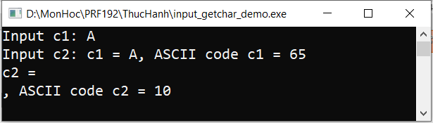
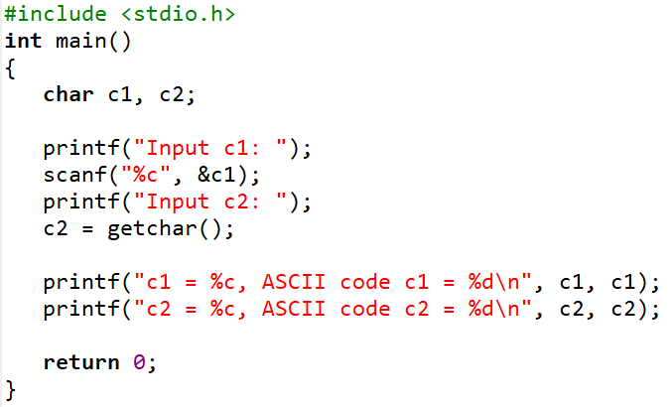
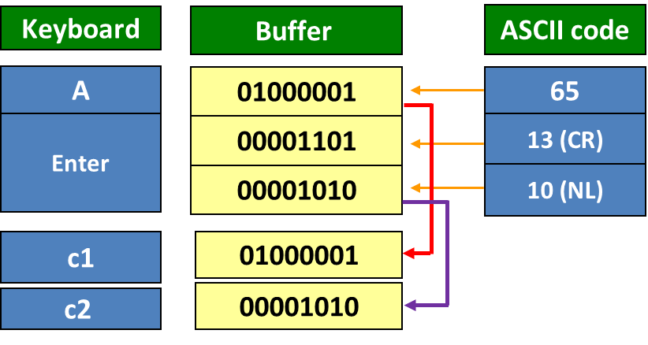
getchar() function: Problem
Write a program input two character variables from STDIN. Print out the value and ASII code.
The problem is that after user presses ‘A’ and ENTER (2 code: 13, 10), ASCII codes of them are put into the keyboard buffer. The function scanf(…) will get ‘A’ to c1. The remaining codes, 13 and 10, are interpreted to the character ‘\n’ – code 10 only, to c2 by the function getchar(). So, you can not get a new character for c2.

Slide 38
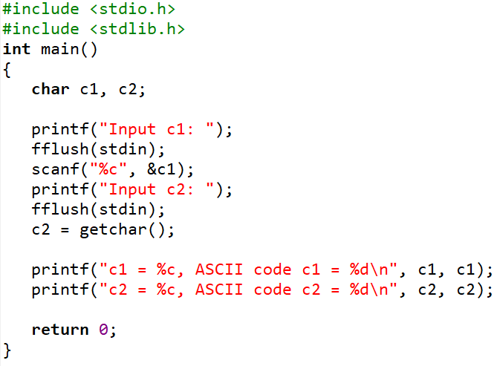
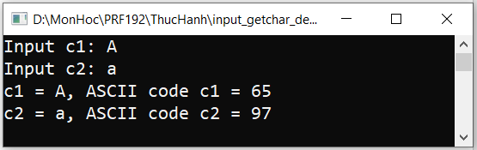
getchar() function: Solution 1
fflush(stdin) used to clear input buffer
Warning: The fflush(stdin) function should not be overused. This function is not defined in the C standard library and is not supported by other compilers.

Slide 39
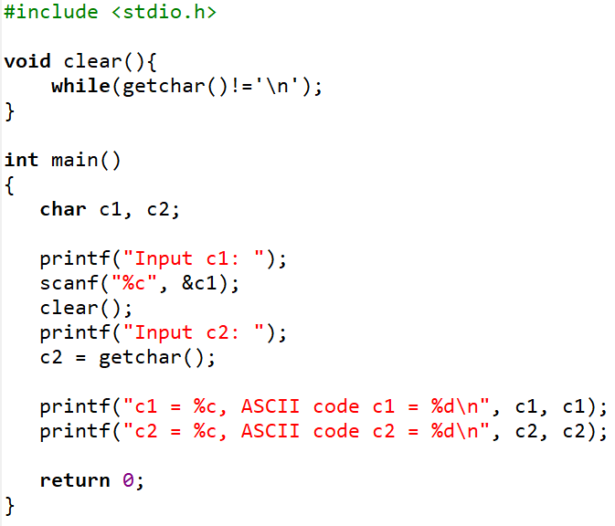
getchar() function: Solution 2
The user-defined function for clearing the keyboard buffer

Slide 40
Exercise 2: Input Characters
Develop a program that will accept a string of characters until the key ENTER is pressed then number of digits, number of alphabets, and number of other characters are printed out.
Hint:
Variable: char c;
int numOfDigits=0, numOfAlpha=0, numOfOthers = 0
Algorithm
While (c=getchar() != ‘\n’)
{ if c is a digit then numOfDigits++ ;
else if c is an alphabet then numOfAlpha++;
else numOfOthers++;
}
Print out numOfDigits;
Print out numOfDigits;
Print out numOfOthers;
Using library functions in ctype.h

Slide 41
3 - scanf(…) function
scanf retrieves data values from the standard input stream buffer under format control.
Syntax: scanf(format string, &identifier , ... )
scanf extracts data values from the standard input stream buffer until scanf has.
Interpreted and processed the entire format string,
Found a character that does not meet the next conversion specification in the format string, in which case scanf leaves the offending character in the buffer, or emptied the buffer, in which case scanf waits until the user adds more data values.

Slide 42
scanf(…) function (cont.)
Some things are concerned when the scanf(…) function is used:
How to specify the input format string?
How to separate input data?
How to realize that how many data were inputted successfully?
How to remove the byte ‘\n’ in the keyboard buffer after an input operation? Is clearing the buffer is the only way?
We will get the answers in the following slides.

Slide 43
scanf(…): Conversion Specifiers
Specifier | Input value | Use with
%c %*c | character | char Remove one character in the input buffer
%d | decimal | char, int, short, long, long ong
%u | decimal | unsigned int, char, int, short, long, long long
%o | octal | unsigned int, char, int, short, long, long long
%x %X | hexadecimal | unsigned int, char, int, short, long, long long
%ld | long | long
%f | float | float
%lf | double | double
%llf | long double | long double
Data from the keyboard are passed to the buffer as characters (ASCII codes). So, conversion specifiers are instructions that specifying how to converse character data to typed-data. If a specifier does not match the data type of a variable, the conversion is incorrect.

Slide 44
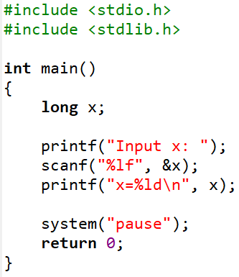
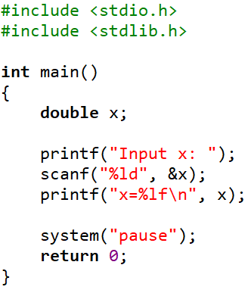


scanf(…): Conversion Specifiers (cont.)
The conversion specifier does not match the data type long
The conversion specifier does not match the data type double

Slide 45
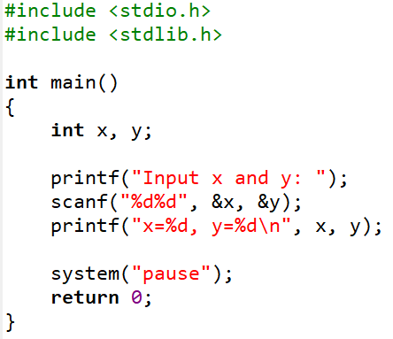

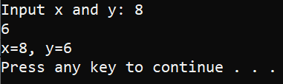

scanf(…) function: Default Separators
If a input value is number lead by a whitespace , scanf treats the whitespace as a separator (The whitespace characters include newline, horizontal tab, form feed, vertical tab and space characters).
Space character
New line / Enter
Tab character

Slide 46
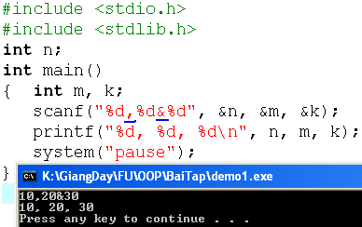
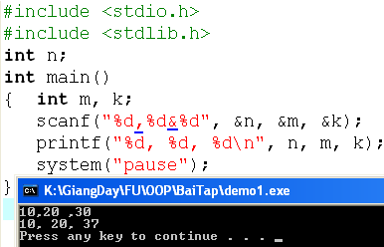
scanf(…) function: User-defined Separators
User can specify the character for separating input data.
User-define separators will override default separators

Slide 47
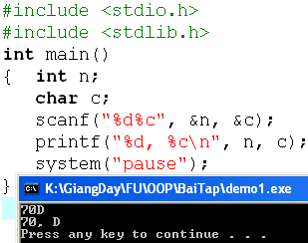
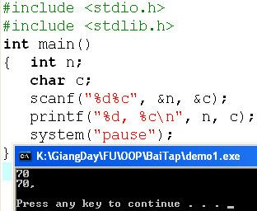
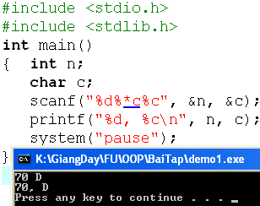
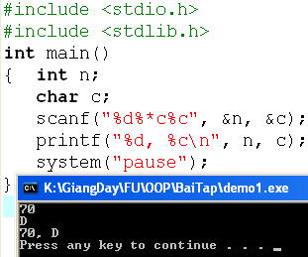
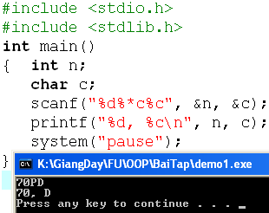
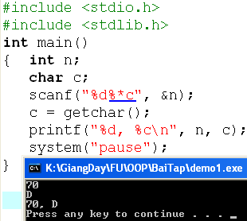
scanf(…) function: Using %*c for removing a character
Input: 70 ENTER
‘\n’

Slide 48
scanf(…) function: Number of data fields are inputted
Return values from the scanf function:
scanf returns the number of addresses successfully filled or EOF.
0 indicates that scanf did not fill any address,
1 indicates that scanf filled the first address successfully,
2 indicates that scanf filled the first and second addresses successfully,
...
EOF (-1) indicates that scanf did not fill any address AND encountered an end of data character.
The return code from scanf does not reflect success of %* conversions.

Slide 49
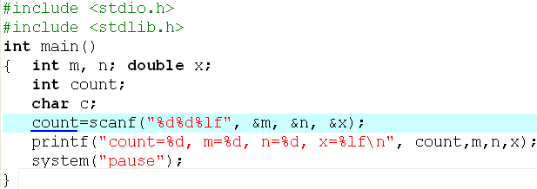





Number of data fields are inputted (cont.)

Slide 50
4 - Input Validation
We cannot predict how the user will input the data values:
Whether the user will enter them as requested or not.
One user may make a mistake
Or another user may simply try to break the program.
The program should have code for trapping all erroneous input, which includes:
Invalid characters
Trailing characters
Out-of-range input
Incorrect number of input fields

Slide 51
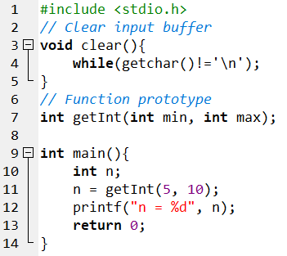
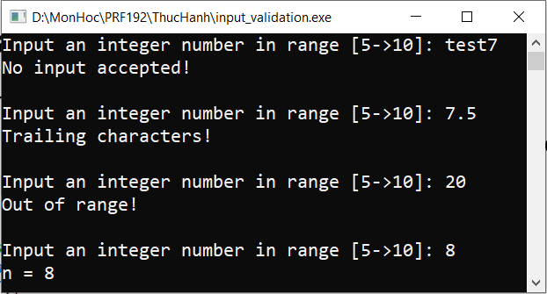
Input Validation: Example
This is a function will ensure that inputted integer must be in the range [min, max] and no invalid characters or trailing character following inputted digits (EXCEPT the ENTER key)

Slide 52
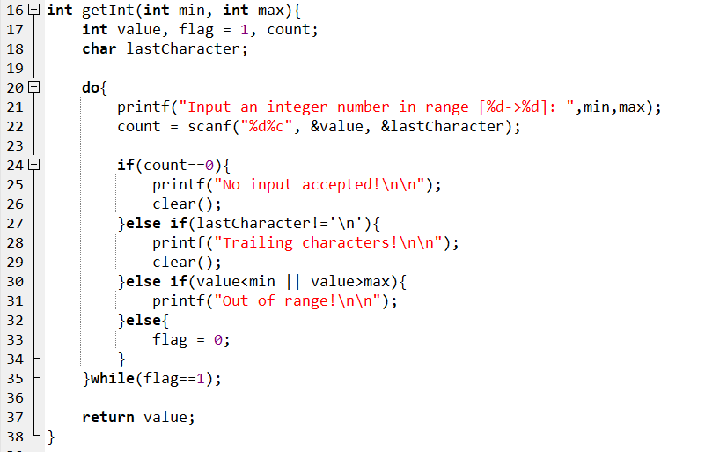
Input Validation: Example (cont.)

Slide 53
Exercise 3: Input Validation
Design and code a function named getDouble that receives two double values (a lower limit and an upper limit) and returns user input that lies between the limiting values. Your function rejects any input that includes trailing characters or lies outside the specified limits.

Slide 54
Summary
Input and Validation
Types of Input
getchar
scanf
Input validation
Q&A

Slide 55
Formatted Output

Slide 56
Formatted Output
Standard output is buffered. The standard output buffer empties to the standard output device whenever the buffer receives a newline character or the buffer is full.
Buffering enables a program to continue executing without waiting for the output device to finish displaying the most recently received characters.
The library stdio.h containing functions for print out data:
putchar(int) : character
printf ( format_string, varList): list of data

Slide 57
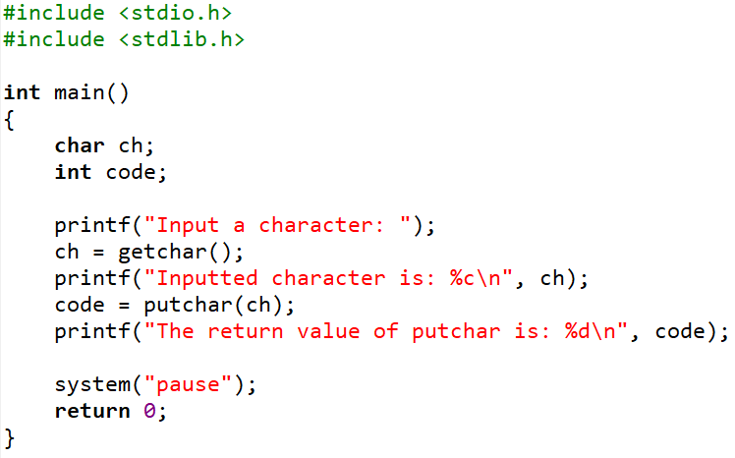
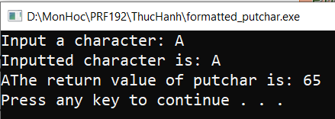
putchar(int) function
putchar writes the character received to the standard output stream buffer and returns the character written or EOF if an error occurred.
Syntax: int putchar( int );
For example: putchar('a');

Slide 58
printf(…) function
printf sends data under format control to the standard output stream buffer and returns the number of characters sent.
Syntax: printf ( format string , value, ..., value )
Note:
The format string is a literal string that consists of characters interspersed with conversion specifiers.
Conversion specifier begins with a % and ends with a conversion character

Slide 59
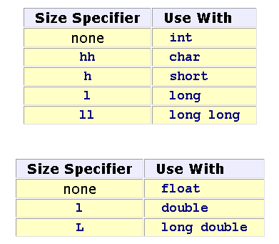
printf(…) function: Format String
Between the % and the conversion character, there may be
% flags width . precision size conversion_character
flags:
- prescribes left justification of the converted value in its field
0 pads the field width with leading zeros
size: identifies the size of data type of the value passed.

Slide 60
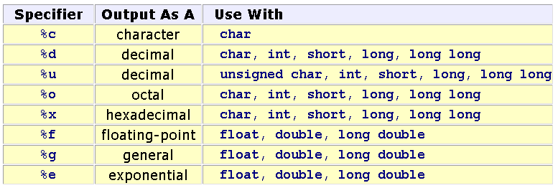
printf(…) function: Conversion Specifiers

Slide 61
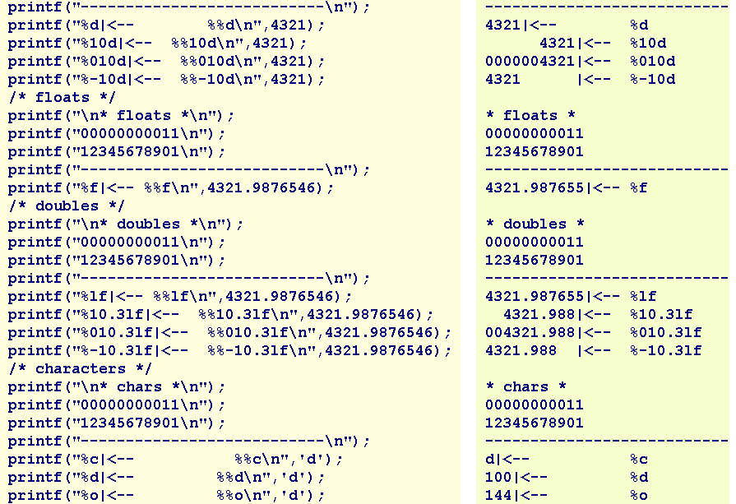
printf(…) function: Example 1

Slide 62
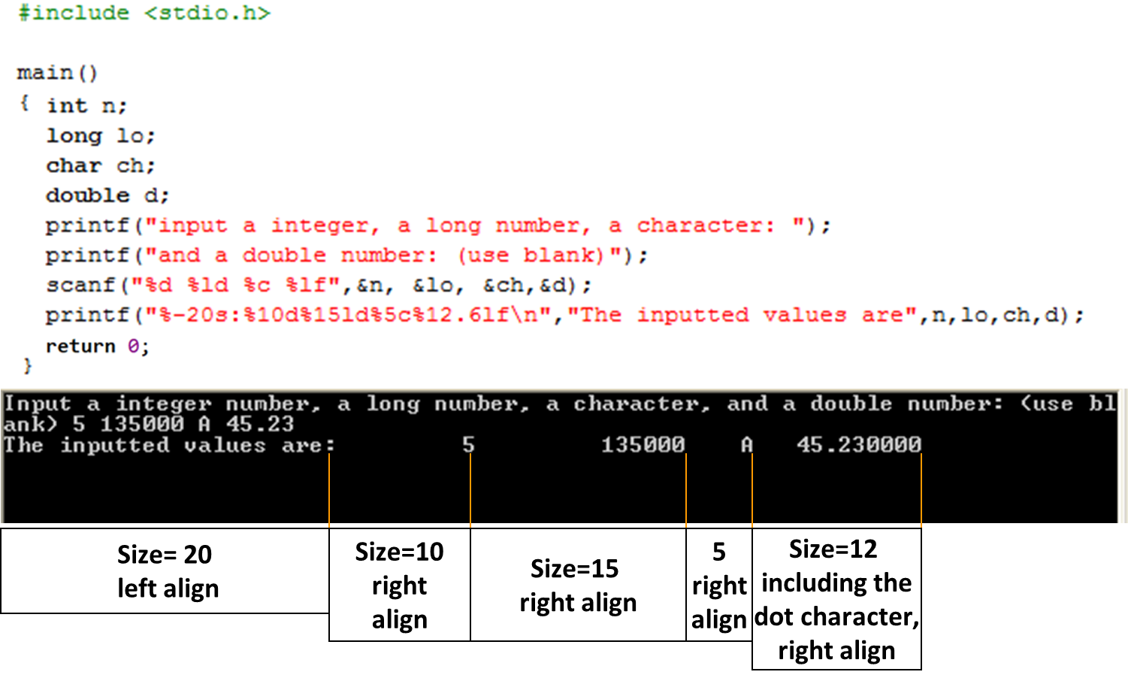
printf(…) function: Example 2

Slide 63
Summary
Formatted Output
putchar
printf
Q&A

Slide 64
Exercise 4:
Write a C program using the following simple menu:
1- Processing date data
2- Character data
3- Quit
Choose an operation:
When user chooses 1: User will enter values of date, month, year then the program will announce whether this date is valid or not.
When user chooses 2: User will enter two characters, then the program will print out ASCII codes of characters between them using descending order. Example:
Input: ca
Output:
c: 99, 63h
b: 98, 62h
a: 97, 61h

Slide 65
Exercise 5:
Write a C program using the following simple menu:
1- Quadratic equation
2- Bank deposit problem
3- Quit
Choose an operation:
When user chooses 1: User will enter values describing a quadratic equation then the program will print out its solution if it exists.
When user chooses 2: User will enter his/her deposit ( a positive number), monthly rate ( a positive number but less than or equal to 0.1), number of months ( positive integer), then the program will print out his/her amount after this duration.

